Slide 1
Presentation By
Dr David Wyatt
Goal-Oriented Strategic Modelling
Using the i* Framework (Part 2)

Slide 2
Outline
Actors and their links
Modelling views
Intentional elements
Social dependencies
Linking intentional elements
2
Notes:
Source: Good i-star Language Guide Presentation.pdf, page 15. © F. Dalpiaz, X. Franch, J. Horkoff (2016). Content adapted into the supplied iStar.pptx design. Original diagram images retain their source notation.

Slide 3

Running example
University travel reimbursement
  Students organise trips to conferences.
  They rely on travel agencies and the university’s trip management information system.
  Multiple alternatives exist to arrange a trip.
3
Notes:
Source: Good i-star Language Guide Presentation.pdf, page 16. © F. Dalpiaz, X. Franch, J. Horkoff (2016). Content adapted into the supplied iStar.pptx design. Original diagram images retain their source notation.

Slide 4
Outline: actors and their links
Current topic
Actors and their links
Modelling views
Intentional elements
Social dependencies
Linking intentional elements
4
Notes:
Source: Good i-star Language Guide Presentation.pdf, page 17. © F. Dalpiaz, X. Franch, J. Horkoff (2016). Content adapted into the supplied iStar.pptx design. Original diagram images retain their source notation.

Slide 5
Actors
Organisations are social entities.
Their operation relies on effective interaction among a number of actors.
An Actor is an active, autonomous entity that aims to achieve its goals by exercising its know-how, in collaboration with other actors.
Travel
agency
5
Notes:
Source: Good i-star Language Guide Presentation.pdf, page 18. © F. Dalpiaz, X. Franch, J. Horkoff (2016). Content adapted into the supplied iStar.pptx design. Original diagram images retain their source notation.

Slide 6
Agents and roles
iStar 2.0 distinguishes two types of actor: agent and role.
Agent: an actor with a concrete, physical manifestation, such as an individual, an organisation or a department.
Role: an abstract characterisation of a social actor’s behaviour within a specialised context or domain.
Univ. of
Wonderland
PhD
student
6
Notes:
Source: Good i-star Language Guide Presentation.pdf, page 19. © F. Dalpiaz, X. Franch, J. Horkoff (2016). Content adapted into the supplied iStar.pptx design. Original diagram images retain their source notation.

Slide 7
Which one should I use?
Can I identify a concrete individual or (sub)organisation?
Do I want to characterise as an abstract class?
I do not know yet, or the distinction does not matter.
Univ. of
Wonderland
Use an Agent
PhD
student
Use a Role
Travel
agency
Use an Actor
7
Notes:
Source: Good i-star Language Guide Presentation.pdf, page 20. © F. Dalpiaz, X. Franch, J. Horkoff (2016). Content adapted into the supplied iStar.pptx design. Original diagram images retain their source notation.

Slide 8
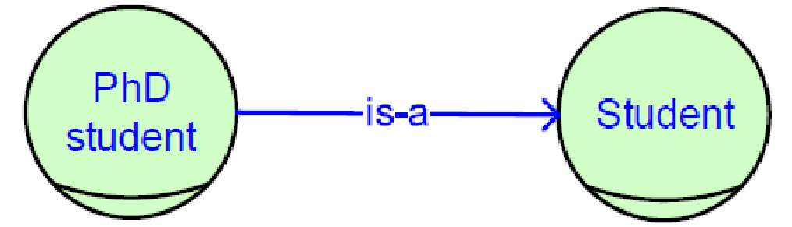
Actor association links: is-a
Actor links relate multiple actors, including agents and roles.
iStar 2.0 offers binary, directed actor links.
is-a represents generalisation / specialisation.
It applies from role to role, or actor to actor.
It does not apply to agents. Why?
8
Notes:
Source: Good i-star Language Guide Presentation.pdf, page 21. © F. Dalpiaz, X. Franch, J. Horkoff (2016). Content adapted into the supplied iStar.pptx design. Original diagram images retain their source notation.

Slide 9
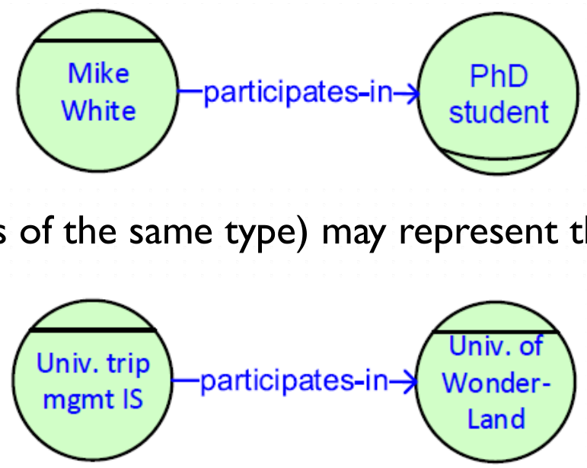
Actor association links: participates-in
participates-in represents an association between two actors other than is-a.
Its meaning depends on the linked elements.
  Agent to role may represent the plays relationship
  Linking elements of the same type may represent a part-of relationship.
9
Notes:
Source: Good i-star Language Guide Presentation.pdf, page 22. © F. Dalpiaz, X. Franch, J. Horkoff (2016). Content adapted into the supplied iStar.pptx design. Original diagram images retain their source notation.

Slide 10
Outline: intentional elements
Actors and their links
Modelling views
Current topic
Intentional elements
Social dependencies
Linking intentional elements
11
Notes:
Source: Good i-star Language Guide Presentation.pdf, page 24. © F. Dalpiaz, X. Franch, J. Horkoff (2016). Content adapted into the supplied iStar.pptx design. Original diagram images retain their source notation.

Slide 11
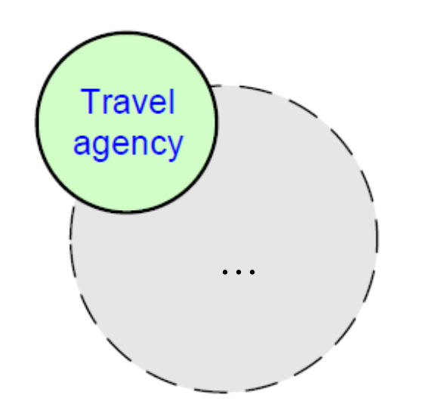
Intentional elements
iStar 2.0 focuses on intentions: things that actors want.
Intentional elements appear inside an actor boundary, representing that actor’s perspective.
Four types: goal, quality, task and resource.
An empty actor boundary can be hidden.
12
Notes:
Source: Good i-star Language Guide Presentation.pdf, page 25. © F. Dalpiaz, X. Franch, J. Horkoff (2016). Content adapted into the supplied iStar.pptx design. Original diagram images retain their source notation.

Slide 12
Goals
A goal is a state of affairs an actor wants to achieve, with clear-cut criteria of achievement.
Examples: “Amsterdam–Gifu travel booked”, “Paper published” and “Tickets booked”.
A clear criterion determines whether the goal has been achieved, for example, did I reach Gifu?
Goals are represented as ovals.
Tickets
booked
13
Notes:
Source: Good i-star Language Guide Presentation.pdf, page 26. © F. Dalpiaz, X. Franch, J. Horkoff (2016). Content adapted into the supplied iStar.pptx design. Original diagram images retain their source notation.

Slide 13
Qualities
A quality is an attribute for which an actor desires some level of achievement.
As attributes, qualities always relate to an entity.
Examples: performance of a system, yearly profit of an organisation, and quick booking of a trip.
Qualities guide the search for ways to achieve goals.
Qualities use curved, cloud-like shapes.
Quick
booking
14
Notes:
Source: Good i-star Language Guide Presentation.pdf, page 27. © F. Dalpiaz, X. Franch, J. Horkoff (2016). Content adapted into the supplied iStar.pptx design. Original diagram images retain their source notation.

Slide 14
Tasks
A task represents actions that an actor wants to execute.
Tasks usually serve the purpose of achieving a goal.
Examples: “Pay for tickets”, “Take the train” and “Scan the receipt”.
Tasks are represented as diamonds.
Pay for
tickets
15
Notes:
Source: Good i-star Language Guide Presentation.pdf, page 28. © F. Dalpiaz, X. Franch, J. Horkoff (2016). Content adapted into the supplied iStar.pptx design. Original diagram images retain their source notation.

Slide 15
Resources
A resource is a physical or informational entity that an actor requires to perform a task.
Examples: credit card, server and personal details.
Resources are represented as rectangles.
Credit
card
16
Notes:
Source: Good i-star Language Guide Presentation.pdf, page 29. © F. Dalpiaz, X. Franch, J. Horkoff (2016). Content adapted into the supplied iStar.pptx design. Original diagram images retain their source notation.

Slide 16
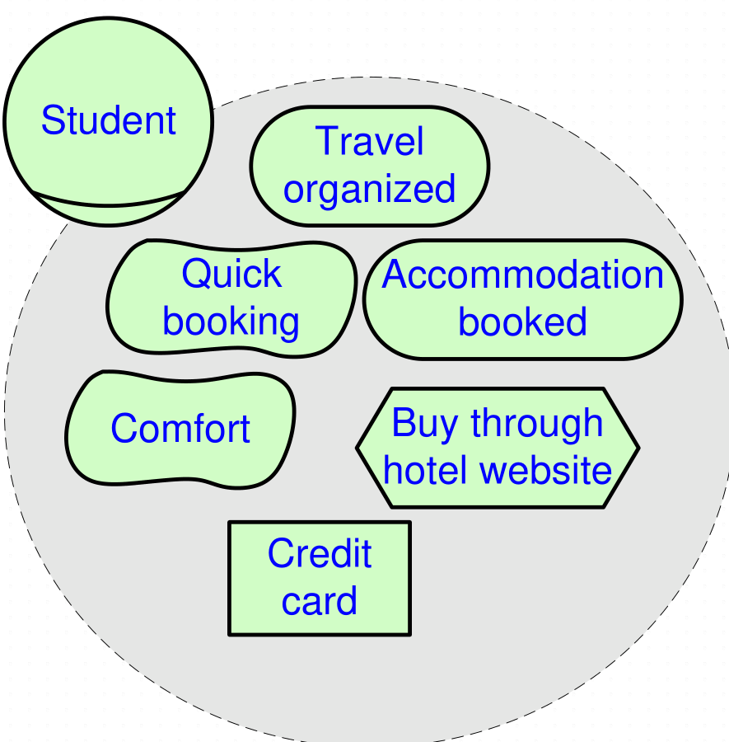
Intentional elements inside actor boundaries
17
Notes:
Source: Good i-star Language Guide Presentation.pdf, page 30. © F. Dalpiaz, X. Franch, J. Horkoff (2016). Content adapted into the supplied iStar.pptx design. Original diagram images retain their source notation.

Slide 17
Outline: social dependencies
Actors and their links
Modelling views
Intentional elements
Current topic
Social dependencies
Linking intentional elements
18
Notes:
Source: Good i-star Language Guide Presentation.pdf, page 31. © F. Dalpiaz, X. Franch, J. Horkoff (2016). Content adapted into the supplied iStar.pptx design. Original diagram images retain their source notation.

Slide 18
Dependencies
Social relationships take the form of dependencies. A dependency has five arguments:
Depender: the actor that depends on provision of the dependum.
DependerElmt: the intentional element where the dependency starts. It explains why the dependency exists.
Dependum: the intentional element that forms the object of the dependency.
Dependee: the actor that should provide the dependum.
DependeeElmt: the intentional element explaining how the dependee intends to provide the dependum.
19
Notes:
Source: Good i-star Language Guide Presentation.pdf, page 32. © F. Dalpiaz, X. Franch, J. Horkoff (2016). Content adapted into the supplied iStar.pptx design. Original diagram images retain their source notation.

Slide 19
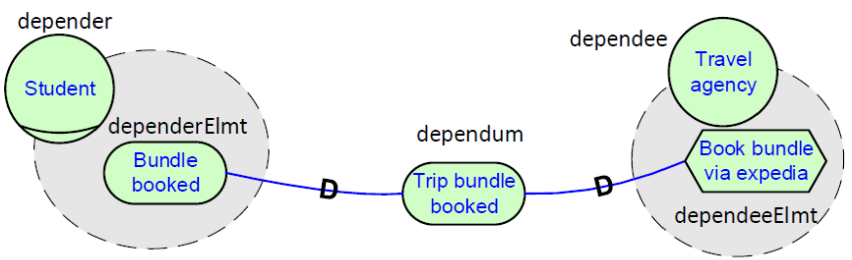
Dependencies: an example
20
Notes:
Source: Good i-star Language Guide Presentation.pdf, page 33. © F. Dalpiaz, X. Franch, J. Horkoff (2016). Content adapted into the supplied iStar.pptx design. Original diagram images retain their source notation.

Slide 20
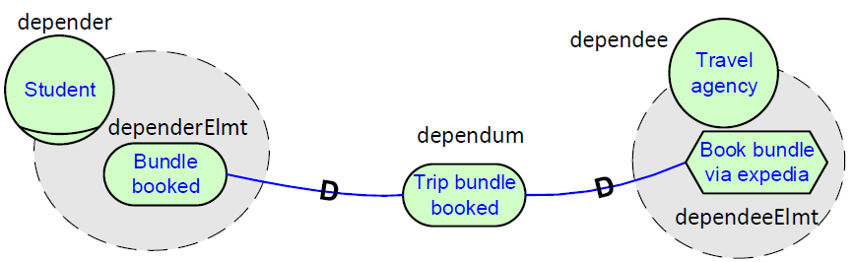
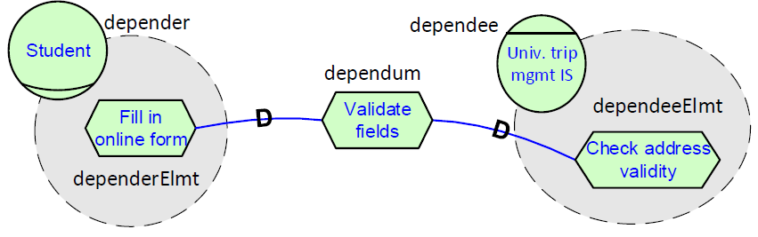
Dependencies: comparing examples
Any differences?
21
Notes:
Source: Good i-star Language Guide Presentation.pdf, page 34. © F. Dalpiaz, X. Franch, J. Horkoff (2016). Content adapted into the supplied iStar.pptx design. Original diagram images retain their source notation.

Slide 21
Dependum types
The dependum’s type determines the meaning of the dependency.
Goal: the dependee chooses how to achieve the goal.
Quality: the dependee chooses how to satisfy the quality sufficiently.
Task: the dependee executes the task in a prescribed way.
Resource: the dependee makes the resource available to the depender.
Different dependum types give the dependee different degrees of freedom.
22
Notes:
Source: Good i-star Language Guide Presentation.pdf, page 35. © F. Dalpiaz, X. Franch, J. Horkoff (2016). Content adapted into the supplied iStar.pptx design. Original diagram images retain their source notation.

Slide 22
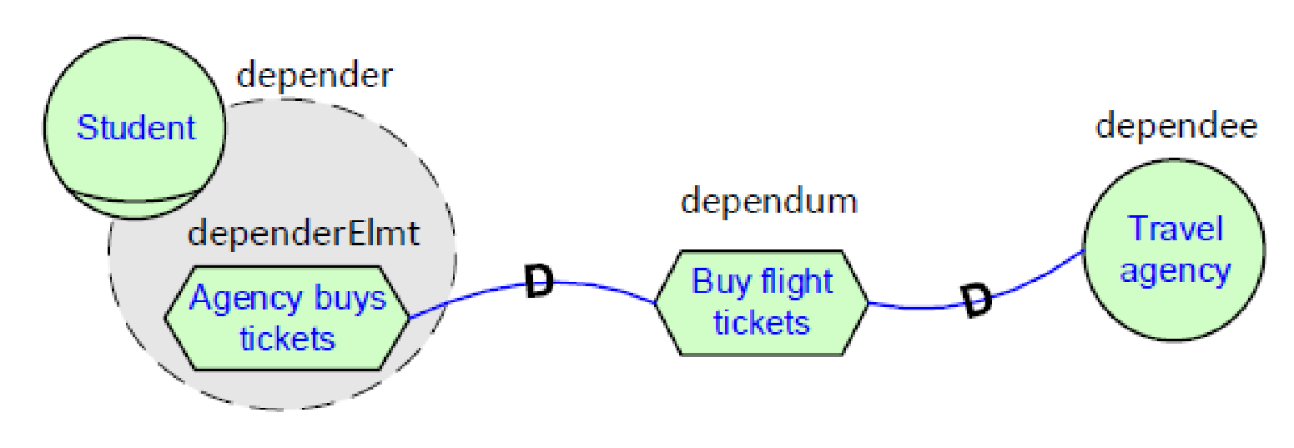
Omitting dependency parts
Omitting dependerElmt leaves unspecified why the dependency exists.
Omitting dependeeElmt leaves unspecified how the dependency will be fulfilled.
23
Notes:
Source: Good i-star Language Guide Presentation.pdf, page 36. © F. Dalpiaz, X. Franch, J. Horkoff (2016). Content adapted into the supplied iStar.pptx design. Original diagram images retain their source notation.

Slide 23
Outline: linking intentional elements
Actors and their links
Modelling views
Intentional elements
Social dependencies
Current topic
Linking intentional elements
24
Notes:
Source: Good i-star Language Guide Presentation.pdf, page 37. © F. Dalpiaz, X. Franch, J. Horkoff (2016). Content adapted into the supplied iStar.pptx design. Original diagram images retain their source notation.

Slide 24
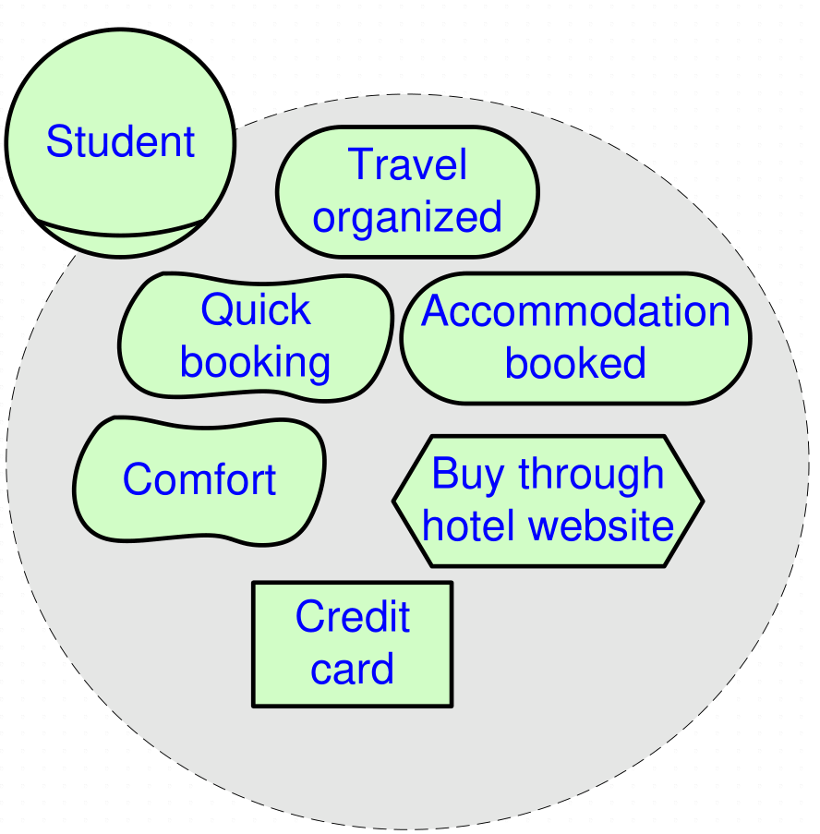
Intentional element links
The elements within an actor boundary are interrelated.
So far, we have seen no ways to relate them.
Any idea?
25
Notes:
Source: Good i-star Language Guide Presentation.pdf, page 38. © F. Dalpiaz, X. Franch, J. Horkoff (2016). Content adapted into the supplied iStar.pptx design. Original diagram images retain their source notation.

Slide 25
Intentional element links: overview
Four link types: refinement, NeededBy, contribution and qualification.
Link starts from ↓ / points to → | Goal | Quality | Task | Resource
Goal | Refinement | Contribution | Refinement | n/a
Quality | Qualification | Contribution | Qualification | Qualification
Task | Refinement | Contribution | Refinement | n/a
Resource | n/a | Contribution | NeededBy | n/a
26
Notes:
Source: Good i-star Language Guide Presentation.pdf, page 39. © F. Dalpiaz, X. Franch, J. Horkoff (2016). Content adapted into the supplied iStar.pptx design. Original diagram images retain their source notation.

Slide 26
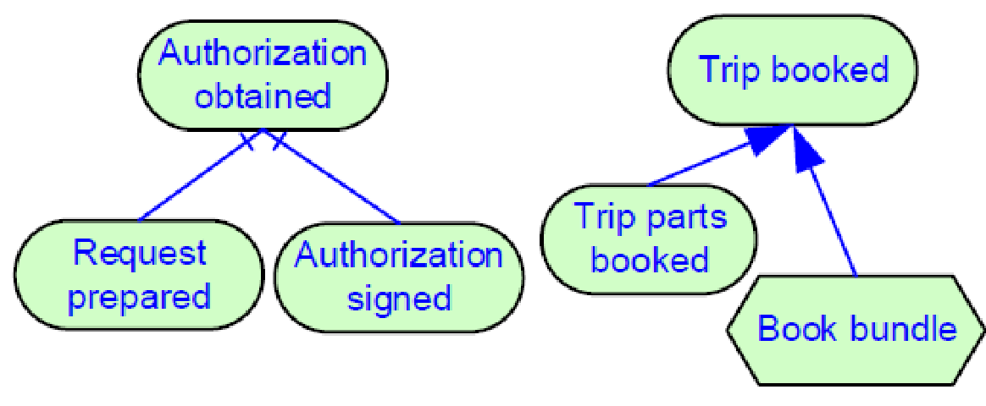
Refinement
Refinement links goals and tasks hierarchically.
It is an n-ary relationship from one parent to one or more children.
An intentional element can be the parent in at most one refinement link.
AND: fulfilment of all n children (n ≥ 2) fulfils the parent.
Inclusive OR: fulfilment of at least one child fulfils the parent.
AND refinement OR refinement
27
Notes:
Source: Good i-star Language Guide Presentation.pdf, page 40. © F. Dalpiaz, X. Franch, J. Horkoff (2016). Content adapted into the supplied iStar.pptx design. Original diagram images retain their source notation.

Slide 27
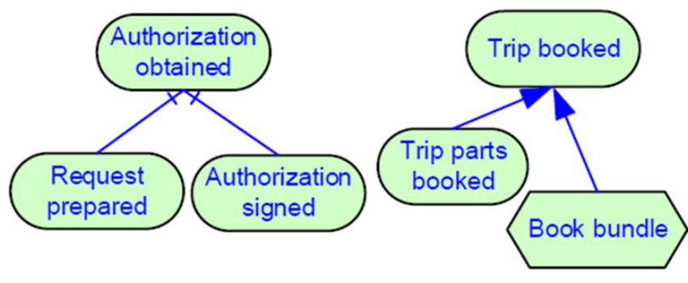
Refinement with a goal as parent
Refinement’s meaning depends on the types of connected elements.
If the parent is a goal:
AND-refinement:
  A child goal is a sub-state of affairs that is part of the parent goal.
  A child task is a subtask that must be fulfilled.
OR-refinement:
  A child goal is a sub-goal that can be achieved to fulfil the parent goal.
  A child task is a particular way of fulfilling the parent goal.
28
Notes:
Source: Good i-star Language Guide Presentation.pdf, page 41. © F. Dalpiaz, X. Franch, J. Horkoff (2016). Content adapted into the supplied iStar.pptx design. Original diagram images retain their source notation.

Slide 28
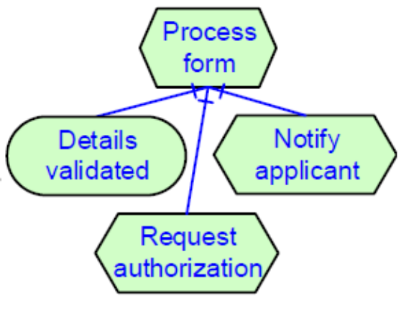
Refinement with a task as parent
If the parent is a task:
AND-refinement:
  A child goal is a goal that is uncovered by analysing the parent task.
  A child task is a subtask that is identified as part of the parent task.
OR-refinement:
  A child goal is a goal that is uncovered by analysing the parent substitute for the original task.
  A child task is a particular way of executing the parent task.
29
Notes:
Source: Good i-star Language Guide Presentation.pdf, page 42. © F. Dalpiaz, X. Franch, J. Horkoff (2016). Content adapted into the supplied iStar.pptx design. Original diagram images retain their source notation.

Slide 29
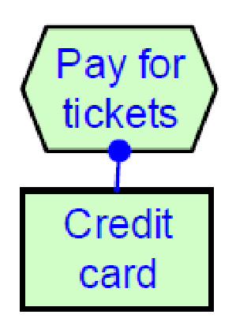
NeededBy
NeededBy links a task with a resource.
It indicates that the actor needs the resource to execute the task.
It does not explain the reason for the need, such as consumption or reading.
30
Notes:
Source: Good i-star Language Guide Presentation.pdf, page 43. © F. Dalpiaz, X. Franch, J. Horkoff (2016). Content adapted into the supplied iStar.pptx design. Original diagram images retain their source notation.

Slide 30
Contribution
Contribution links represent the effects of intentional elements on qualities.
  These qualitative links help analysts choose between alternative goals or tasks.
A quality can be
  fulfilled (satisfied), with sufficient positive evidence.
  denied, with strong negative evidence.
No details here on how fulfilment / denial are calculated.
31
Notes:
Source: Good i-star Language Guide Presentation.pdf, page 44. © F. Dalpiaz, X. Franch, J. Horkoff (2016). Content adapted into the supplied iStar.pptx design. Original diagram images retain their source notation.

Slide 31
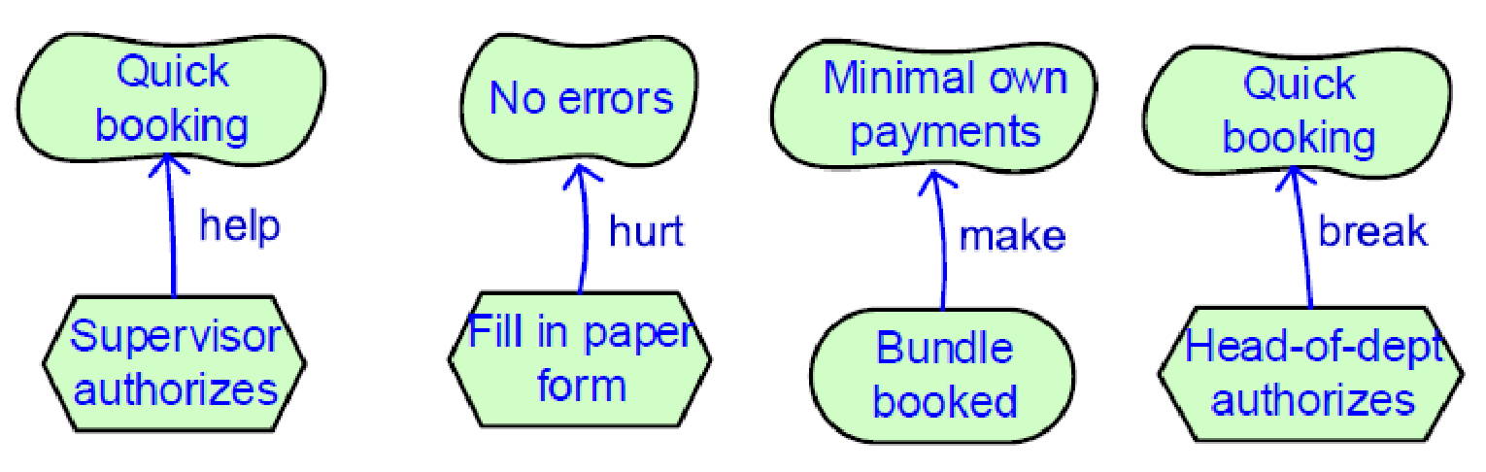
Contribution types
Four types, expressing that “the source provides…”
  Make (++): sufficient positive evidence to satisfy the target.
  Help (+): weak positive evidence to satisfy the target.
  Hurt (-): weak evidence against satisfaction, or for denial, of the target.
  Break (--): sufficient evidence against satisfaction, or for denial, of the target.
32
Notes:
Source: Good i-star Language Guide Presentation.pdf, page 45. © F. Dalpiaz, X. Franch, J. Horkoff (2016). Content adapted into the supplied iStar.pptx design. Original diagram images retain their source notation.

Slide 32
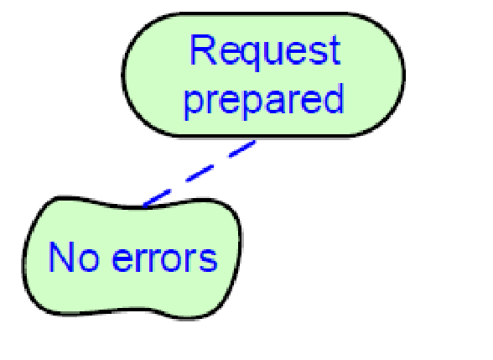
Qualification
Qualification relates a quality to its subject: a task, goal or resource.
Examples:
  “Quick booking” refers to “Trip parts booked” and elaborates how this goal might be achieved.
  “No errors” refers to errors that might arise when fulfilling “Request prepared”.
33
Notes:
Source: Good i-star Language Guide Presentation.pdf, page 46. © F. Dalpiaz, X. Franch, J. Horkoff (2016). Content adapted into the supplied iStar.pptx design. Original diagram images retain their source notation.

Slide 33
Outline: modelling views
Current topic
Actors and their links
Modelling views
Intentional elements
Social dependencies
Linking intentional elements
34
Notes:
Source: Good i-star Language Guide Presentation.pdf, page 47. © F. Dalpiaz, X. Franch, J. Horkoff (2016). Content adapted into the supplied iStar.pptx design. Original diagram images retain their source notation.

Slide 34
Model views
An analyst creates an iStar 2.0 model.
The model can be visualised through multiple perspectives or model views.
Standard views exist, including two from i*
  Strategic Rationale (SR)
  Strategic Dependency (SD)
Hybrid views can also be defined.
35
Notes:
Source: Good i-star Language Guide Presentation.pdf, page 48. © F. Dalpiaz, X. Franch, J. Horkoff (2016). Content adapted into the supplied iStar.pptx design. Original diagram images retain their source notation.

Slide 35
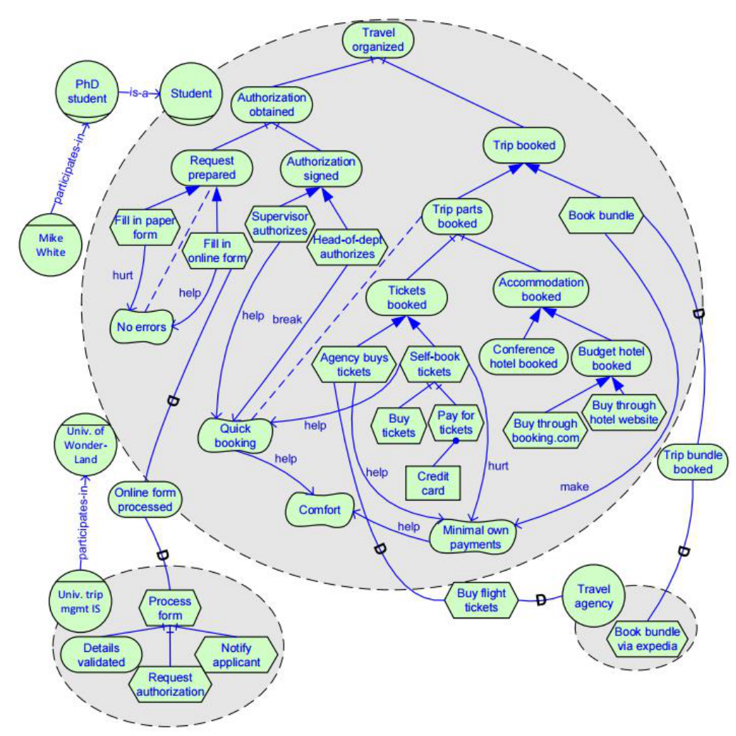
Strategic rationale in iStar 2.0
Shows all details captured in the model:
Actors
Actor links
Intentional elements
Dependencies
Intentional element links
36
Notes:
Source: Good i-star Language Guide Presentation.pdf, page 49. © F. Dalpiaz, X. Franch, J. Horkoff (2016). Content adapted into the supplied iStar.pptx design. Original diagram images retain their source notation.

Slide 36
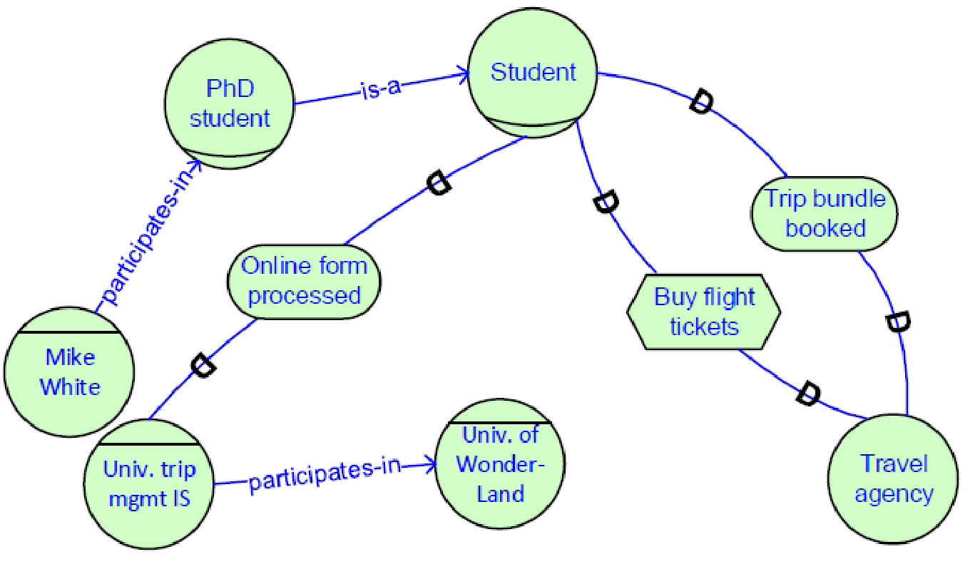
Strategic dependency in iStar 2.0
Shows the social part of the model:
Actors
Actor links
Dependencies
Hides intentional elements inside actor boundaries and their links.
37
Notes:
Source: Good i-star Language Guide Presentation.pdf, page 50. © F. Dalpiaz, X. Franch, J. Horkoff (2016). Content adapted into the supplied iStar.pptx design. Original diagram images retain their source notation.

Slide 37
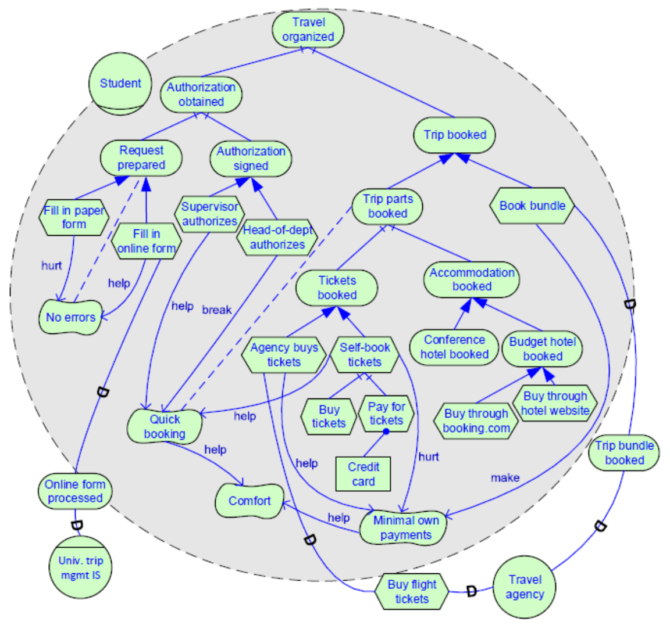
A hybrid view
Example: some actor boundaries are open, while others remain closed.
Actor links are hidden.
Other hybrid views:
  Functional view: no qualities.
  Actor view: only actors and their links.
38
Notes:
Source: Good i-star Language Guide Presentation.pdf, page 51. © F. Dalpiaz, X. Franch, J. Horkoff (2016). Content adapted into the supplied iStar.pptx design. Original diagram images retain their source notation.

Slide 38

Any questions?
Thank you for your attention
Dr David Wyatt

